Slide 1
Peptic ulcer bleeding
Incidence and associated mortality rate
Notes:
Peptic ulcer bleeding – incidence and associated mortality rate

Slide 2
Peptic ulcer bleeding is a substantial health issue
Incidence
Recurrence
19.4–79.0 cases per 100,000 individuals/year in Europe¹
Up to 31%¹
90% of re-bleeds occur in the first 7 days^{2,3}
Peptic ulcer bleeding
Mortality
Cost
Average 30-day mortality of 8.7%¹
Estimated cost to employers and health care providers (USA): $5.7 billion per year⁴
¹Lau JY, et al. Gastroenterology 2008;134(4 Suppl 1):A32; ²Bini EJ & Cohen J. Gastrointest Endosc 2003;58:707–1; ³Chiu PW, et al. Gut 2003;52:1403–7; ⁴Sonnenberg A & Everhart JE. Am J Gastroenterol 1997;92:614–20
Notes:
2
Peptic ulcer bleeding is a substantial health issue
A systematic review of the epidemiology of complicated peptic ulcer revealed that peptic ulcer bleeding occurs with an incidence of 19.4–79.0 cases per 100,000 adults per year in Europe.¹ Bleeding recurs in up to 31% of patients¹ and perforation in up to 25%. Approximately 90% of re-bleeds occur in the first 7 days.^{2,3} Furthermore, peptic ulcer bleeding is life-threatening: the weighted average mortality rate within the first 30 days after a peptic ulcer bleed is 8.7%.¹
Peptic ulcer bleeding therefore incurs significant costs to healthcare providers and employers, which have been estimated to be approximately $5.7 billion per year in the USA.⁴
1. Lau JY, et al. Gastroenterology 2008:134(4 Suppl 1):A32.
2. Bini EJ & Cohen J. Gastrointest Endosc 2003;58:707–1.
3. Chiu PW, et al. Gut 2003;52:1403–7.
4. Sonnenberg A & Everhart JE. Am J Gastroenterol 1997;92:614–20.

Slide 3
Peptic ulcer disease is declining… Time trends of hospitalization
Proportional rate per 10,000 hospitalizations
70
180
Non-white men
60
160
140
50
White men
120
40
100
30
80
White men
60
20
40
Non-white men
10
20
Gastric ulcer
Duodenal ulcer
0
0
1970– 1974
1975– 1979
1980– 1984
1985– 1989
1990– 1995
1970– 1974
1975– 1979
1980– 1984
1985– 1989
1990– 1995
El-Serag HB & Sonnenberg A. Gut 1998;43:327–33
Notes:
Peptic ulcer disease is declining...
Over the last decades, the incidence of peptic ulcer disease, particularly duodenal ulcer disease, has declined (at least in Caucasian populations).¹ This is probably due to the eradication of Helicobacter pylori.
1. El-Serag HB & Sonnenberg A. Gut 1998;43:327–33.
Slide reprinted from El-Serag HB & Sonnenberg A. Gut 1998;43:327–33, with permission from BMJ Publishing Group.

Slide 4
…but there is no significant decline in the incidence of peptic ulcer bleeding
Age-adjusted incidence rate (per 100,000)
14
13.4
ns
1993−1994
12
12.0
2000
10
10.8
ns
9.7
8
6
4
2
0
Duodenal ulcer bleeding
Gastric ulcer bleeding
Van Leerdam ME, et al. Am J Gastroenterol 2003;98:1494–9
ns, not significant
Notes:
…but there is no significant decline in the incidence of peptic ulcer bleeding
Despite the overall decline in the incidence of peptic ulcer disease, the age-adjusted incidence of bleeding peptic ulcer has not changed significantly during the past decade.¹
This possibly reflects the increased use of non-steroidal anti-inflammatory drugs and low dose ASA, and the increasing age of the population during the same time period (patients who develop bleeding peptic ulcers have a high mean age and often have a significant co-morbidity).
Peptic ulcer bleeding therefore remains an important medical emergency.
1. Van Leerdam ME, et al. Am J Gastroenterol 2003;98:1494–9.

Slide 5
Gastric acid inhibits haemostasis in bleeding peptic ulcers
Notes:
Gastric acid inhibits haemostasis in bleeding peptic ulcers
The cessation of bleeding from a peptic ulcer is inhibited by gastric acid, which interferes with clot formation, promotes clot lysis and causes on-going tissue damage.¹
1. Leontiadis GI, et al. Cochrane Database Syst Rev 2006 Jan 25;(1):CD002094.

Slide 6
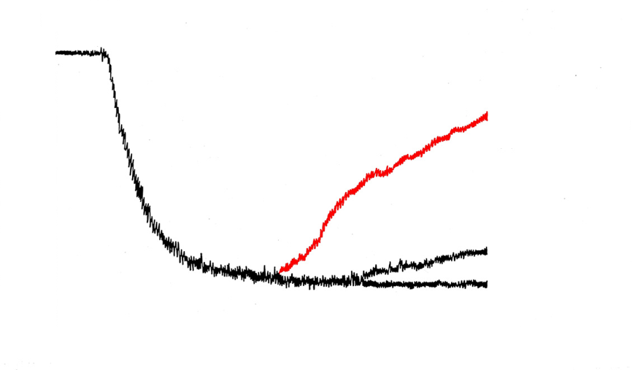
A pH>6 is needed to maintain platelet aggregation
Aggregation (%)
0
20
ADP
pH=6.0
Disaggregation=77%
40
60
Buffer
pH=6.4
Disaggregation=16%
80
pH=7.3
Disaggregation=0%
100
0
1
2
3
4
5
Time (minutes)
ADP, adenosine diphosphate
Green FW, et al. Gastroenterology 1978;74:38–43
Notes:
A pH>6 is needed to maintain platelet aggregation
The first step in repairing the breach of a blood vessel in the upper GI tract is the development of a platelet plug. These early platelet plugs can achieve initial haemostasis for several hours but will then disintegrate unless they are reinforced by a fibrin clot.¹ In vitro data indicate that acid plays an important role in impairing haemostasis and causing clot digestion.
In the in vitro experiment shown in this slide, platelet aggregation was promoted by the addition of adenosine diphosphate, followed by the subsequent application of a buffer solution or dilutions of hydrochloric acid. It shows that, at pH 6, there was disaggregation of 77% of previously aggregated platelets. This effect could be overcome by elevating the pH above 6.² Highly effective acid suppression to elevate the intragastric pH should therefore aid clot formation in upper GI bleeding.
1. Berger S. Can Med Assoc J 1970;102:1271–4.
2. Green FW, et al. Gastroenterology 1978;74:38–43.
Slide reprinted from Green FW, et al. Gastroenterology 1978;74:38–43, with permission from Elsevier, Inc.

Slide 7
Rationale for acid inhibition
pH
Effect
6.7–7.0
6.0
5.4
5.0
4.0
Normal coagulation
77% of platelet aggregates dissolve in 3 min
Platelet aggregation completely inhibited
Plasma coagulation completely inhibited
Breakdown of fibrin clot via peptic activity
Patchett S, et al. Gut 1989;30:1704–7; Low J, et al. Thromb Res 1980;17:819–30
Notes:
Rationale for acid inhibition
An intragastric pH above 4 helps to maintain clotting
The proteolytic enzyme pepsin in the gastric juice, which can cause the breakdown of clots as well as disrupting the mucus/bicarbonate barrier that forms a vital part of the gastroduodenal mucosal defence barrier, is inactivated at pH>4 and irreversibly inactivated at pH>6.¹ Elevation of the intragastric pH above 4 is therefore necessary to reduce the damaging activity of this enzyme and hence maintain clotting.
Patients with bleeding peptic ulcer are likely to need highly effective acid control, in order to elevate the pH above 6 and thus aid platelet aggregation and clot formation followed by continued elevation of the intragastric pH above 4 to help to maintain clotting and prevent re-bleeding.^{2,3}
1. Berstad A. Scand J Gastroenterol 1970;5:343–8.
2. Patchett S, et al. Gut 1989;30:1704–7.
3. Low J, et al. Thromb Res 1980;17:819–30.

Slide 8
Management of peptic ulcer bleeding
Notes:
Management of peptic ulcer bleeding

Slide 9
Initial management of peptic ulcer bleeding
Treatment of peptic ulcer bleeding aims to stabilize the circulation, stop ongoing bleeding and prevent re-bleeding and includes:
fluid replacement (with blood transfusion if needed)
prompt endoscopy, with endoscopic haemostasis if necessary
surgery, if bleeding cannot be controlled by the above measures
Leontiadis GI, et al. Health Technol Assess 2007;11:1–164
Notes:
Initial management of peptic ulcer bleeding
In the initial management of peptic ulcer bleeding, the aims are to stabilize the circulation, stop ongoing bleeding and prevent re-bleeding. Treatment therefore includes:
fluid replacement (with blood transfusion if needed)
prompt endoscopy, with endoscopic haemostasis treatment if necessary
surgery, if bleeding cannot be controlled by the above measures.¹
1. Leontiadis GI, et al. Health Technol Assess 2007;11:1–164.

Slide 10
Forrest classification of bleeding peptic ulcers
Grade Ulcer appearance
Ia Spurting haemorrhage
Ib Oozing haemorrhage
IIa Non-bleeding visible vessel
IIb Adherent clot
IIc Flat pigmented spot
III Clean ulcer base
Forrest JA, et al. Lancet 1974;17:394–7
Notes:
Forrest classification of bleeding peptic ulcers
Based on the endoscopic findings, bleeding peptic ulcers can be categorized according to the Forrest classification.¹
1. Forrest JA, et al. Lancet 1974:17:394–7.

Slide 11
Prevalence of Forrest grades among patients with peptic ulcer bleeding
Forrest III
Grade and ulcer appearance
Forrest I
49%
7%
Forrest IIa
I – active bleeding
IIa – non-bleeding visible vessel
IIb – adherent clot
IIc – flat pigmented spots
III – clean ulcer base
8%
13%
23%
Forrest IIb
Forrest IIc
Lau JY, et al. Endoscopy 1998;30:513–18
Notes:
Prevalence of Forrest grades among patients with peptic ulcer bleeding
A prospective study of 778 consecutive patients presenting with bleeding from peptic ulcers who underwent endoscopy within 24 hours of admission to hospital found that:
7% had active bleeding (Forrest grade 1)
8% had non-bleeding visible vessels (Forrest grade IIa)
13% had adherent clots (Forrest grade IIb)
23% had haematin spots (Forrest grade IIc)
49% had a clean ulcer base (Forrest Grade III).¹
In this study, patients presenting with active bleeding (Forrest grade l) received endoscopic haemostasis (epinephrine injection therapy), whereas those with other grades did not.
1. Lau JY, et al. Endoscopy 1998;30:513–18.

Slide 12
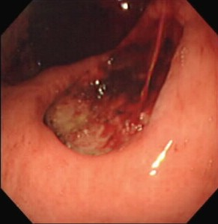
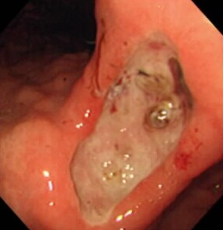
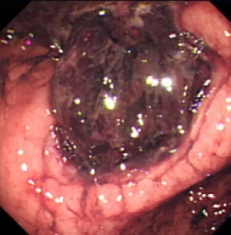
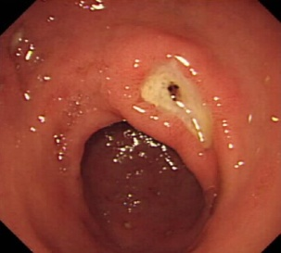
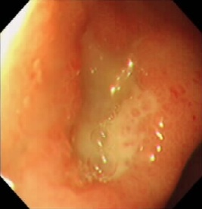
Risk of re-bleeding by Forrest grade
Patients with endoscopic or clinical re-bleeding (%)
100
80
Forrest I*
Forrest IIa
Forrest IIb
Forrest IIc
Forrest III
60
55
40
43
20
22
10
5
0
Laine L & Peterson WL. N Engl J Med 1994;331:717–27
*Patients did not receive endoscopic therapy
Notes:
Risk of re-bleeding by Forrest grade
The prevalence of ulcer re-bleeding is highest in patients with Forrest grade I (55% among those not receiving endoscopic therapy), compared with 43% with grade IIa, 22% with grade IIb, 10% with grade IIc and 5% with grade III. Thus, the Forrest grading of a bleeding peptic ulcer is predictive of the risk of re-bleeding.¹ Furthermore, despite having received endoscopic haemostasis, 19.6% of those with Forrest grade l in the study by Lau et al. (shown on the previous slide) also experienced re-bleeding within 72 hours.²
There is therefore a large unmet medical need in this area, as there is no approved drug to treat these patients and prevent re-bleeding.
1. Laine L & Peterson WL. N Engl J Med 1994;331:717–27
2. Lau JY, et al. Endoscopy 1998;30:513–18.

Slide 13
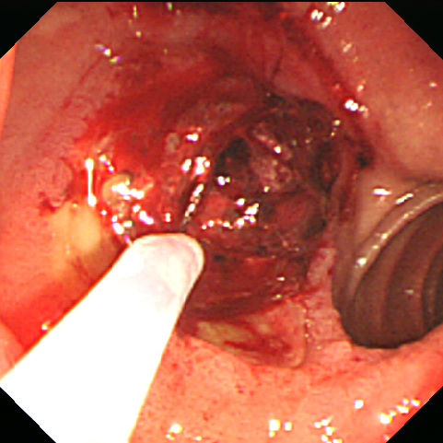
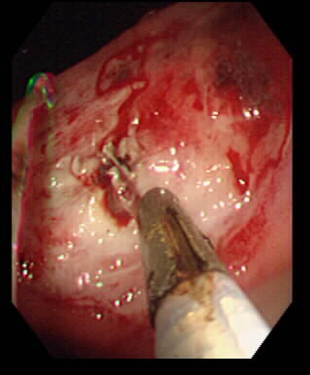
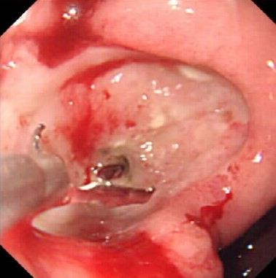
Endoscopic haemostasis
Epinephrine injection
Heater probe
Haemoclip
Monotherapy with either epinephrine injection or thermal treatment (e.g. with a heater probe)
or
A combination of epinephrine injection plus thermal treatment and/or haemoclips
Notes:
Endoscopic haemostasis
Since the late 1980s, endoscopic haemostasis has been widely accepted as the first-line therapy for upper GI bleeding. Contemporary endoscopic treatments include injection therapy (e.g. saline, vasoconstrictors, sclerosing agents, tissue adhesives), thermal therapy (with the use of contact methods, such as multipolar electrocoagulation and heater probe, or non-contact methods, such as argon plasma coagulation) and mechanical therapy (principally endoscopic clips). In practice it usually consists of an epinephrine injection, which has a vasoconstrictive effect and has been shown to help to stop the bleeding, combined with either heater-probe coagulation or the use of mechanical devices such as haemoclips.¹
While endoscopic therapy is effective in achieving initial haemostasis in more than 90% of cases,² the focus then has to turn to preventing re-bleeding, which is experienced by up to 20% of patients and is associated with a high risk of mortality.³
Sung J. Nat Clin Pract Gastroenterol Hepatol 2006;3:24–32.
2. Netzer P, et al. Am J Gastroenterol 1999;94:351–7.
3. Lau J, et al. N Engl J Med 2000;343:310–16.

